Slide 1
Dreamers: Immigrant Youths Fighting for Opportunity
Dr. T. Elizabeth Durden
Associate Professor of Sociology
Bucknell University
Lewisburg Pennsylvania USA

Slide 2
Defining the Dreamers
Undocumented immigrants brought to the United States as children by their parents
1.8 million undocumented children and youths in the United States

Slide 3
Defining the Dreamers
The Federal DREAM Act Development, Relief, and Education for Alien Minors
However, the name stuck “The Dreamers”

Slide 5
Data and Methods
Extension of a larger research project
Variation in state level immigration policies
Inclusive and Exclusive

Slide 6
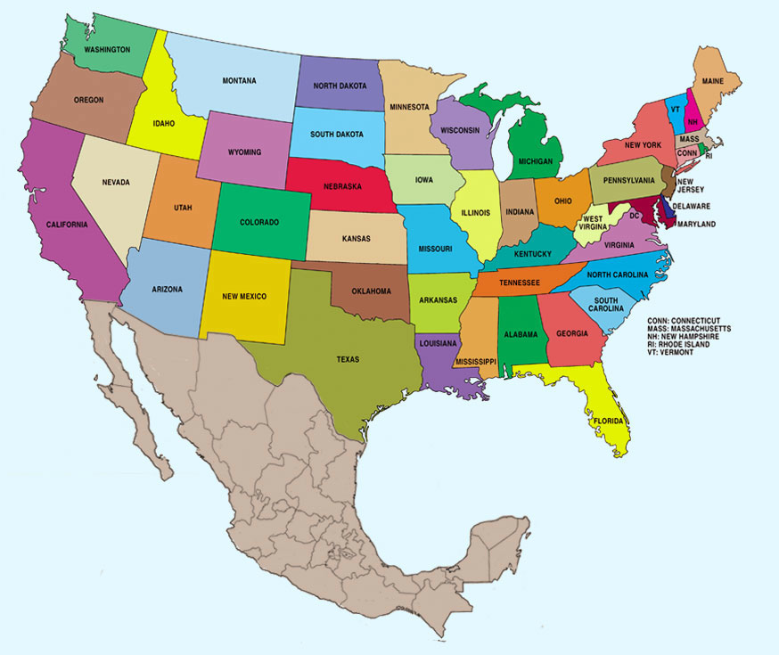

Slide 7
Data and Methods
Extension of a larger research project
Variation in state level immigration policies
Inclusive and Exclusive
Archival research and semi-structured interviews
Dreamers of New Mexico: ongoing interviews with activists and allies

Slide 8
Policy Arenas that Inform Immigrant Youth Activism
Education
K-12
All undocumented children have the right to a high school education
College
Financial Barriers

Slide 9
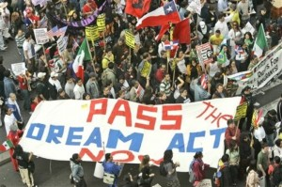

Slide 11
Policy Arenas that Inform Immigrant Youth Activism
DACA
Differed Action for Childhood Arrivals
Executive Order signed by President Obama
No deportations, ability to work
Will expire when Obama leaves office
“Obama gets all this credit for signing DACA, but we have been fighting for this for 20 years!”

Slide 12
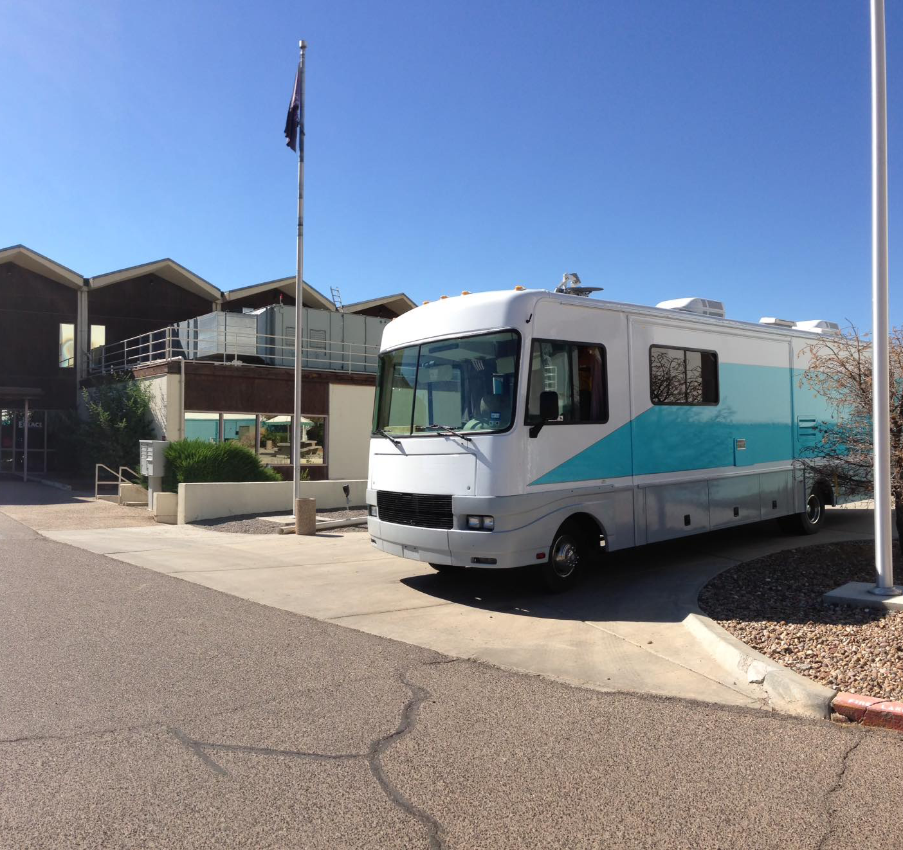
Santa Fe Dreamers Network

Slide 13
University of Mexico Dreamers

Slide 14
Dreamers in the Era of Trump

Slide 15
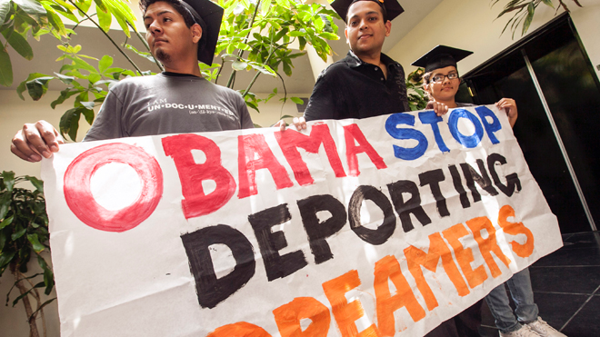
Policy Arenas that Inform Immigrant Youth Activism
Deportations
400,000 deportations a year
More deportations under President Obama than President Clinton and and President George W. Bush

